Slide 1
Teaching, Learning, and Assessing in Remote Learning Environments
FACULTY FRIDAY WEBINARS
FREE Webinar Series
April 3, 2020

Slide 2
Thank you to our sponsor!

Slide 4
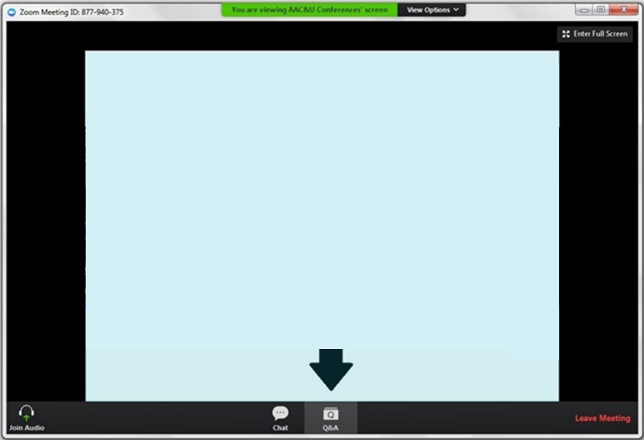
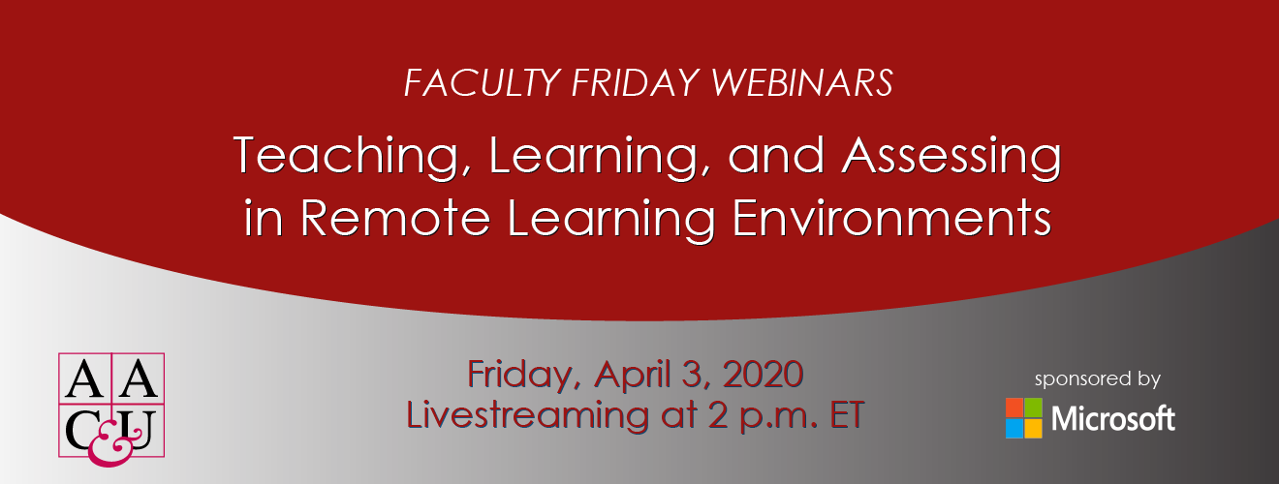
Use Q&A for: Panel discussion
Use Chat for: Technology support
#AACUfaculty
Slides and webinar recording will be posted online: www.aacu.org/webinars/remotelearning

Slide 5
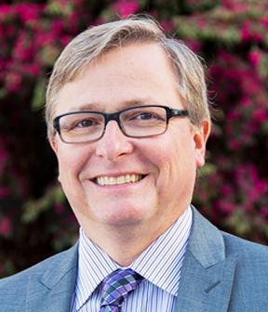
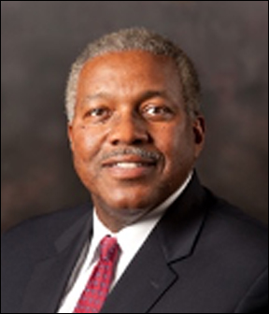
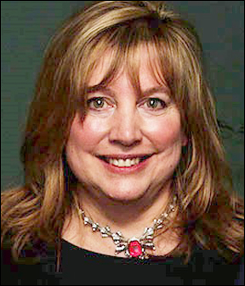
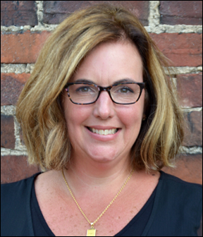
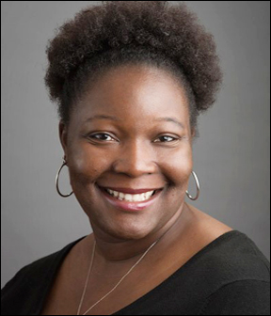
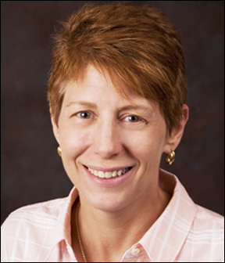
Panelists
Teaching, Learning, and Assessing in Remote Learning Environments
Co-Moderator
C. Edward Watson
Associate Vice President for Quality, Pedagogy, and LEAP Initiatives & CIO, AAC&U
Watson@aacu.org
Robert Maribe (Rob) Branch
Professor of Learning, Design, and Technology and Associate Dept. Head of Career and Information Studies, University of Georgia
Tammie Lea Cumming
Associate Provost and Assistant Vice President for Institutional Effectiveness, Brooklyn College of the City University of New York
Co-Moderator
Kate McConnell
Assistant Vice President for Research and Assessment and Director or VALUE Institute, AAC&U
mcconnell@aacu.org
Bethany L. Miller
Director of Institutional Research, Mary Baldwin University
Bonnie Orcutt
Professor of Economics, Worcester State University

Slide 6
Robert Maribe (Rob) Branch
Professor of learning, design, and technology and associate department
Head of career and information studies, university of georgia
Email: rbranch@uga.edu

Slide 7
Preparing Students for the Learning Environment: A Readiness Activity
An online, asynchronous [interactive] quiz
Prepares students to effectively participate in the course.
Introduces self-regulatory learning
Administered
within the learning management system
Students study Preview Edition of the Readiness Activity
Complete actual Readiness Activity prior to the first class
Students allowed to repeat the Readiness Activity as many times as desired prior to the due date
Highest score is recorded
Incorporates all item types Complete the following sentence:
My primary expectation for this course is _________________________.

Slide 8
Advantages
Encourages active class participation
Increases student engagement
Stimulates interest in the course topics
Facilitates navigating course content in a self-paced, less stressful environment
Elicits deep questions from the students
Allows students to check their understanding immediately
Applies students’ understanding of the course to practical problems
Allows instructor to evaluate students’ understanding and revise, if necessary

Slide 9
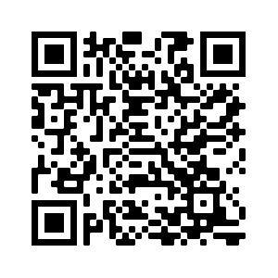
Example Readiness Activity

Slide 10
Tammie Lea Cumming
Associate provost and assistant vice president for Institutional effectiveness, Brooklyn college of the city university of new york
EMAIL: Tammie.Cumming@brooklyn.cuny.edu

Slide 11
Wait… Assessment Continues?
Recognize that the majority of students and faculty moved to a remote learning environment with very little notice or preparation
Acknowledge that assessment results should not be used to evaluate “online learning” as a mode of instruction
Recognize that many are in “triage” mode

Slide 12
Education Goals Remain the Same
Faculty/Instructors should continue to:
Teach within the new framework
Provide feedback on students’ performance through effective assessment
Formative
Summative
Clear expectations for learning objectives/outcomes

Slide 13
Assessing Your Students
Ensuring continuity of learning outcomes/objectives
Identifying/Developing appropriate assignments for the online learning environment
Providing feedback for students so they can continue to learn and understand their needs
Ensuring the validity and fairness of the assessments

Slide 14
NEW AAC&U Assessment Brief Series - Forthcoming
Next Generation Assessment – Looking Forward
Assessment in a time of crisis
“Triage” approach to assessment challenges
An Integrated Approach to Test development for Distance Learning
Performance appraisals for online learning
AAC&U rubrics to enhance online assessment
Validity
Reliability
Fairness
Accreditation before and beyond the self-study

Slide 15
Next Generation Assessment – Looking Forward
Let us hear from you!
Send your topics of interest for the series to:
Terry Rhodes, AAC&U
rhodes@aacu.org
Tammie Cumming, Brooklyn College - CUNY tammie.cumming@brooklyn.cuny.edu
M. David Miller, University of Florida
dmiller@coe.ufl.edu
Gladys Palma de Schrynemakers, School of Labor & Urban
Studies Gladys.Schrynemakers@slu.cuny.edu

Slide 16
Bethany L. Miller
Director of institutional research, Mary baldwin university
Email: blmiller@marybaldwin.edu

Slide 17
What & how are we engaging during the crisis?
Pedagogy
Equity
IR/IE

Slide 18
Bonnie Orcutt
Professor of economics, Worcester state university
Email: borcutt@worcester.edu

Slide 19
Designing Assignments for On-Line Learning I. Less is better than more: fewer well-designed assignments II. Assignment Design Key Characteristics: * Clearly stated learning outcomes * Clearly stated assignment prompt: procedural instructions; content and cognitive tasks – what specifically is the student being asked to do; sequenced instructions that are explicit and detailed *Clearly stated evaluative criteria aligned with the tasks and procedural requirements III. Instructional Supports *within the prompt, course, institution *video recordings (CC) – synchronous and recorded or nonsynchronous * Examples IV. Feedback

Slide 20
Use Q&A for: Panel discussion
Let’s Chat!

Slide 21
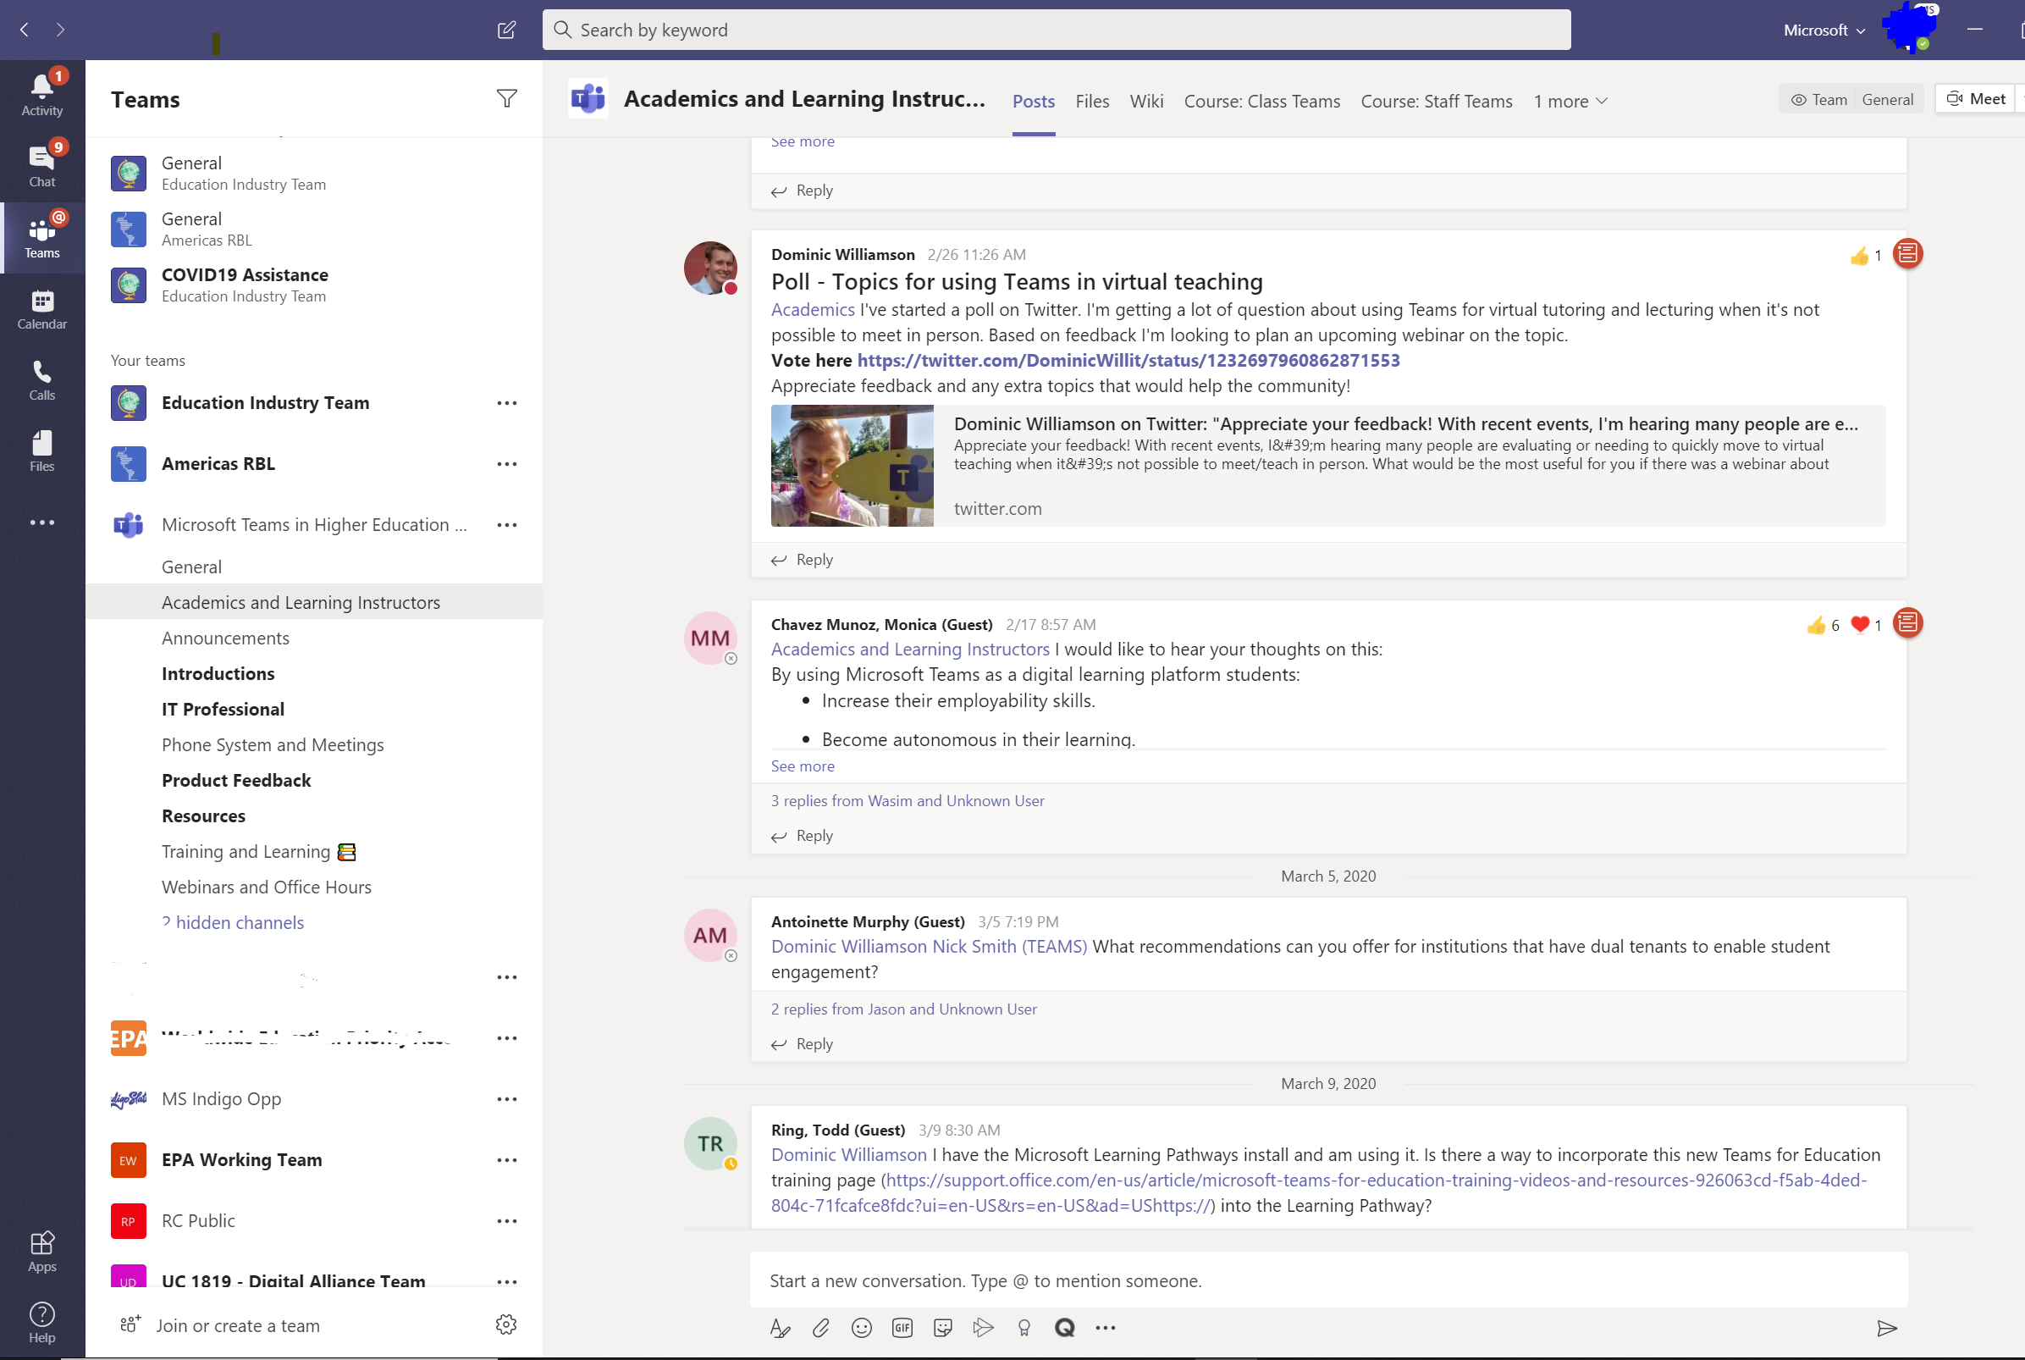
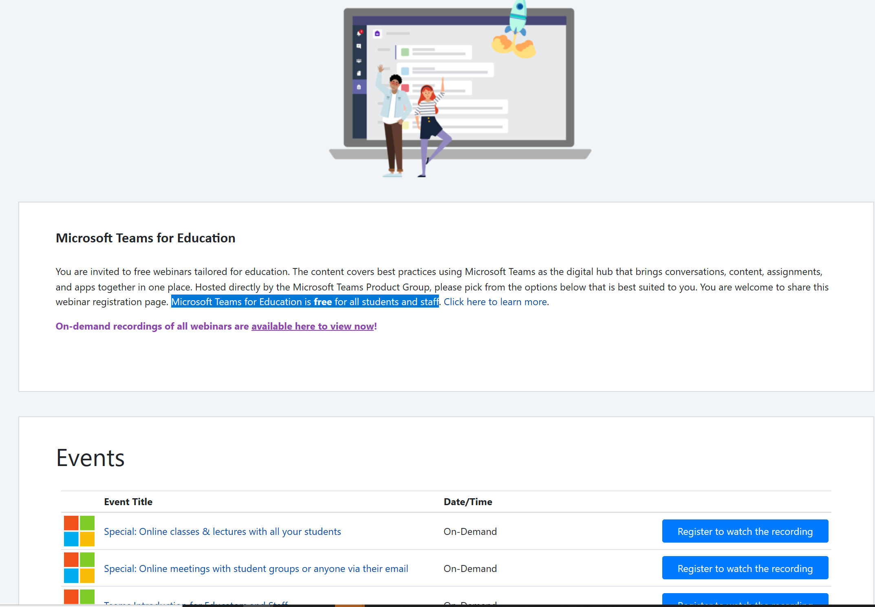
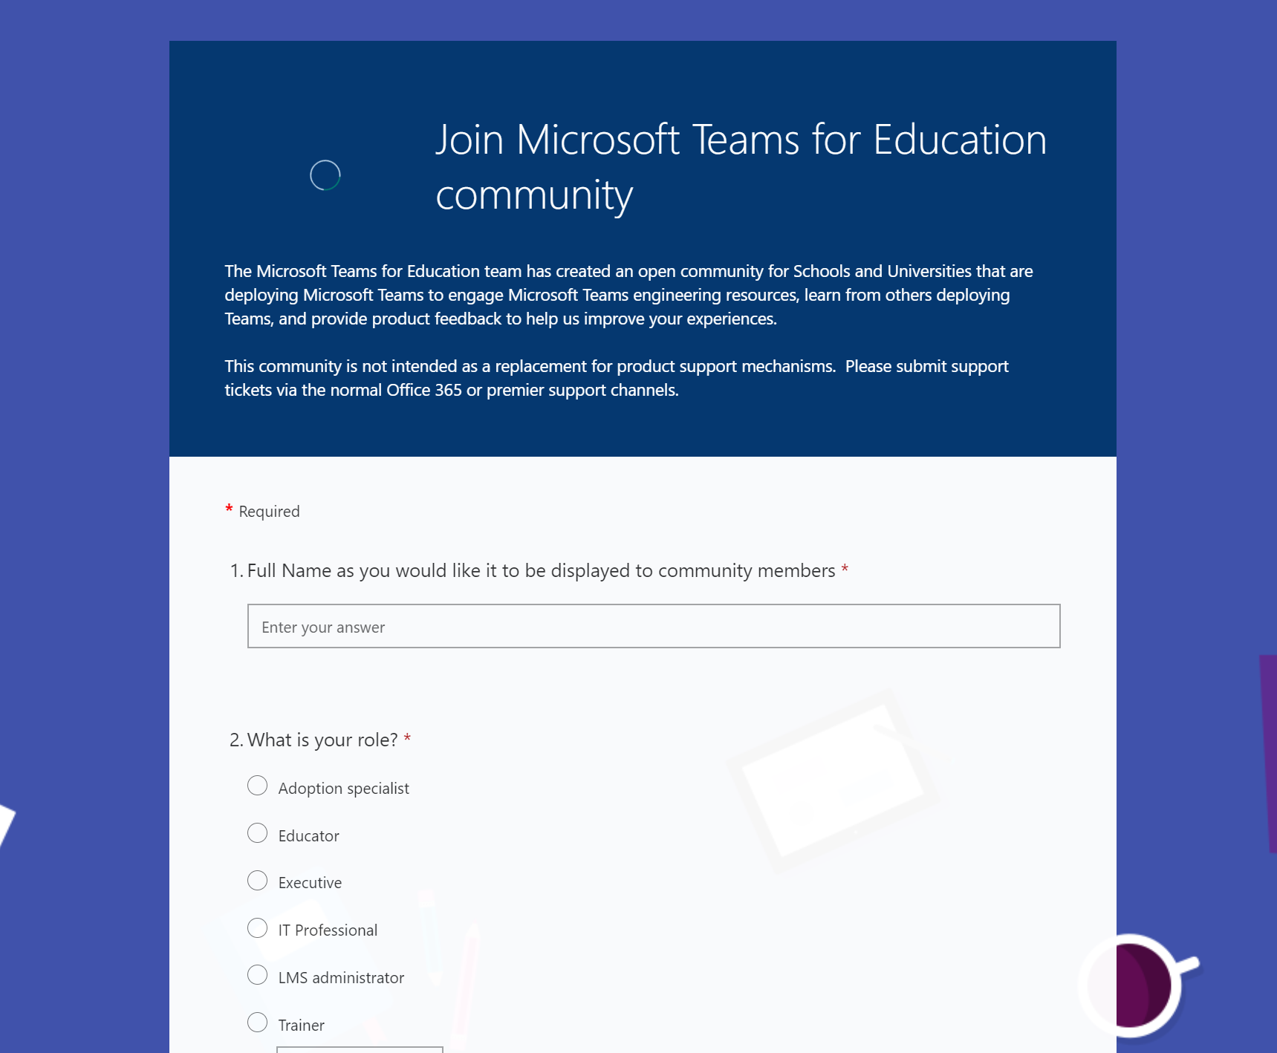
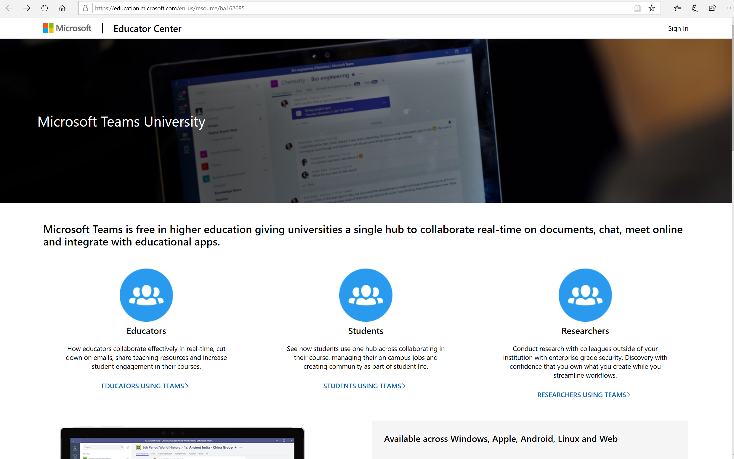
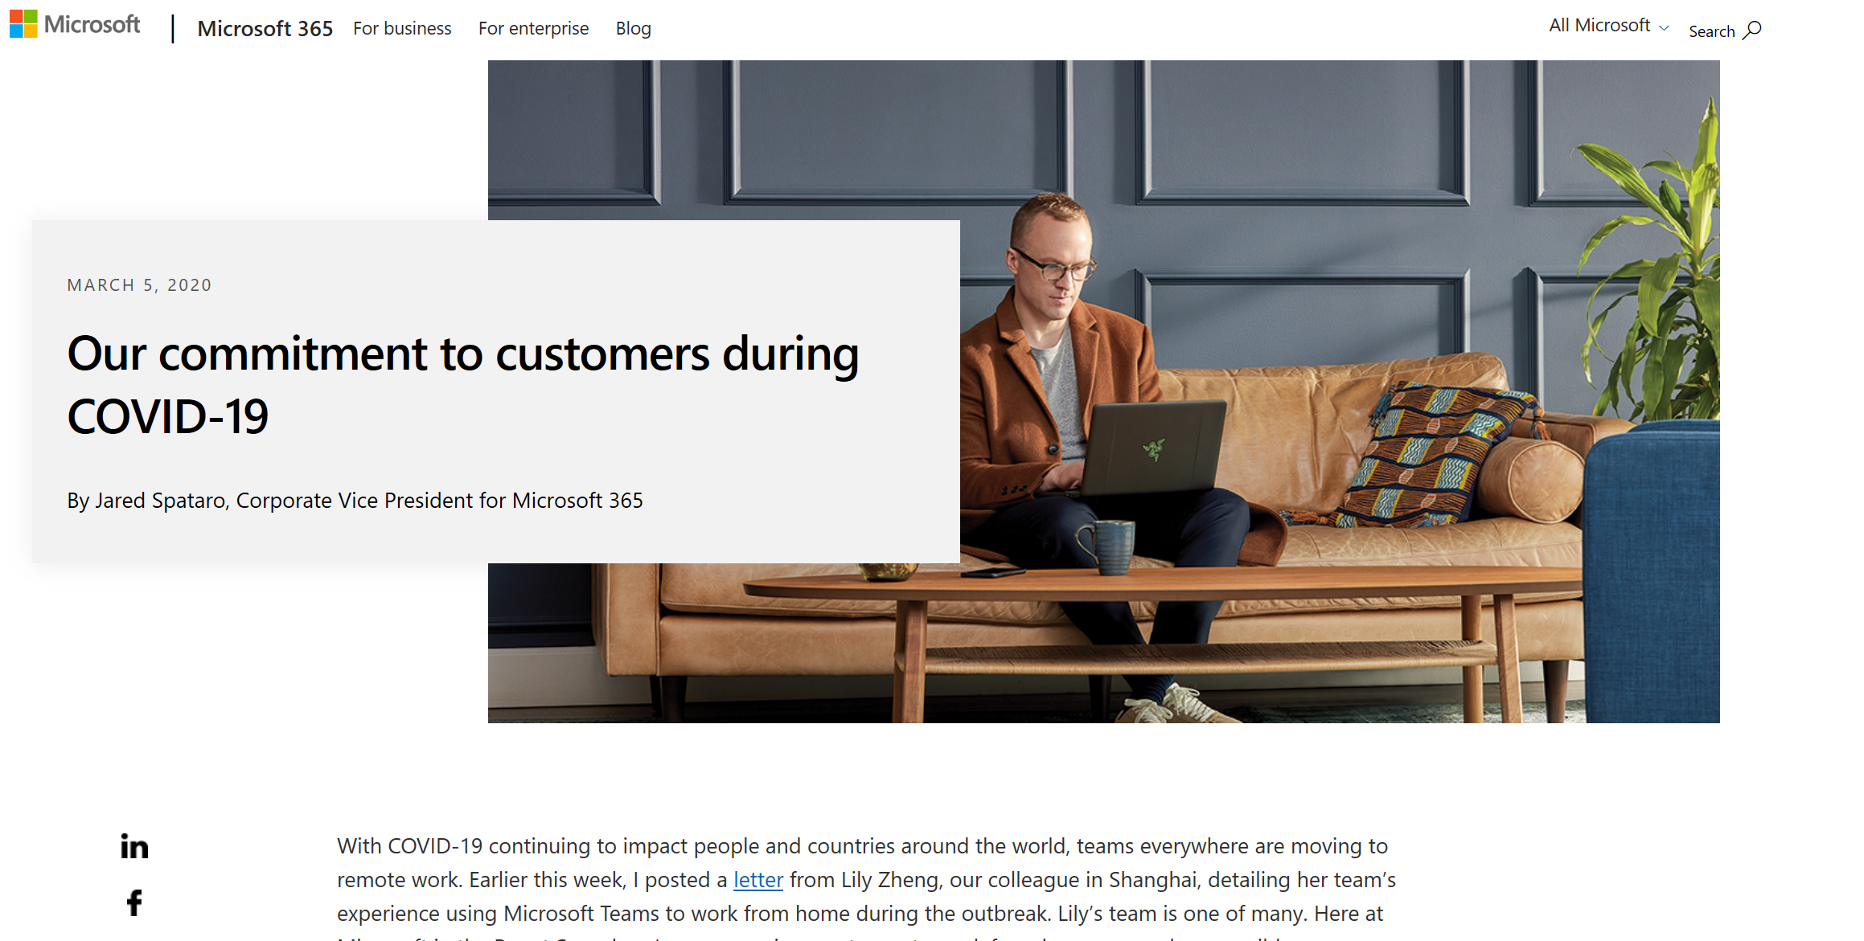
Microsoft Resources for Remote Learning
4/3/2020
Microsoft Teams for Education Events and Webinars
Microsoft Teams for HE Community
Education-specific Webinars including “Online classes and Lectures with all your students”, and “Online meetings with student groups, or anyone with their email”
Request to Join
http://aka.ms/jointeamseducommunity
https://microsoftteams.eventbuilder.com/TeamsEducation
Global community of higher education practitioners using Microsoft Teams in the classroom, as their classroom, and for daily productivity. A Microsoft Team for Microsoft Teams!
Microsoft Teams University
Guides, Videos, and Resources
for Educators Students, Researchers
.
Microsoft COVID-19 Response
https://education.microsoft.com/en-us/resource/ba162685
Notes:
Final Slide

Slide 22
Upcoming AAC&U Webinars
More information online at
www.aacu.org/events/webinar
All webinars are in US Eastern Time. All webinars will be recorded.
Webinar recordings are available online a few weeks after the webinar.

Slide 23
Thank You!

Slide 24
Teaching, Learning, and Assessing in Remote Learning Environments
FACULTY FRIDAY WEBINARS
FREE Webinar Series
April 3, 2020

